Slide 1

AWS Costs Breakdown
A Comprehensive Analysis
July 2025

Slide 2






Understanding Your AWS Spend
Cloud cost management is a critical aspect of maintaining operational efficiency in today's digital landscape. Understanding your AWS expenditure provides valuable insights into resource utilization and helps identify opportunities for optimization.
Identify cost trends and patterns
Pinpoint major cost contributors
Discover optimization opportunities
Balance performance and expenditure

Slide 3
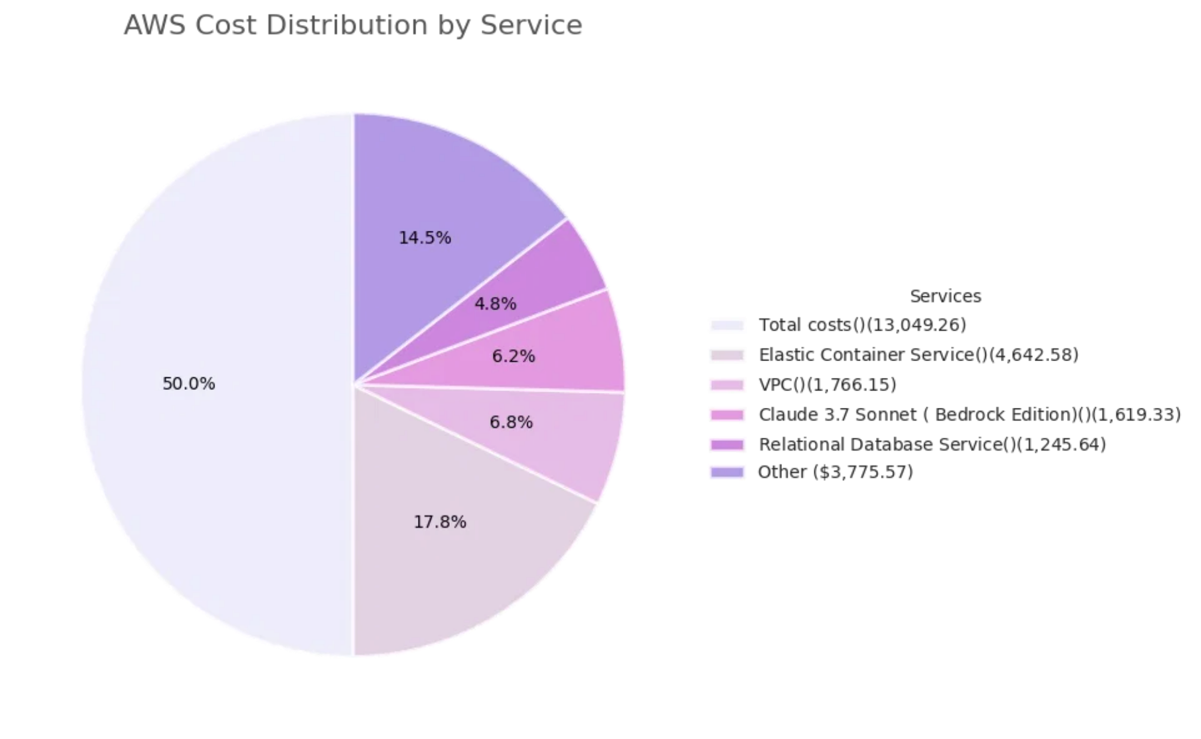




Total AWS Expenditure
Analysis of the AWS cost data reveals the distribution of expenditure across various services. Understanding this breakdown is essential for effective cost management and optimization.
Total AWS Cost: $13,049.26
Elastic Container Service accounts for 35.6% of total costs
VPC and networking services represent 13.5% of expenditure
AI services (Claude models) comprise 12.4% of costs
Database services account for 9.5% of total spending

Slide 4

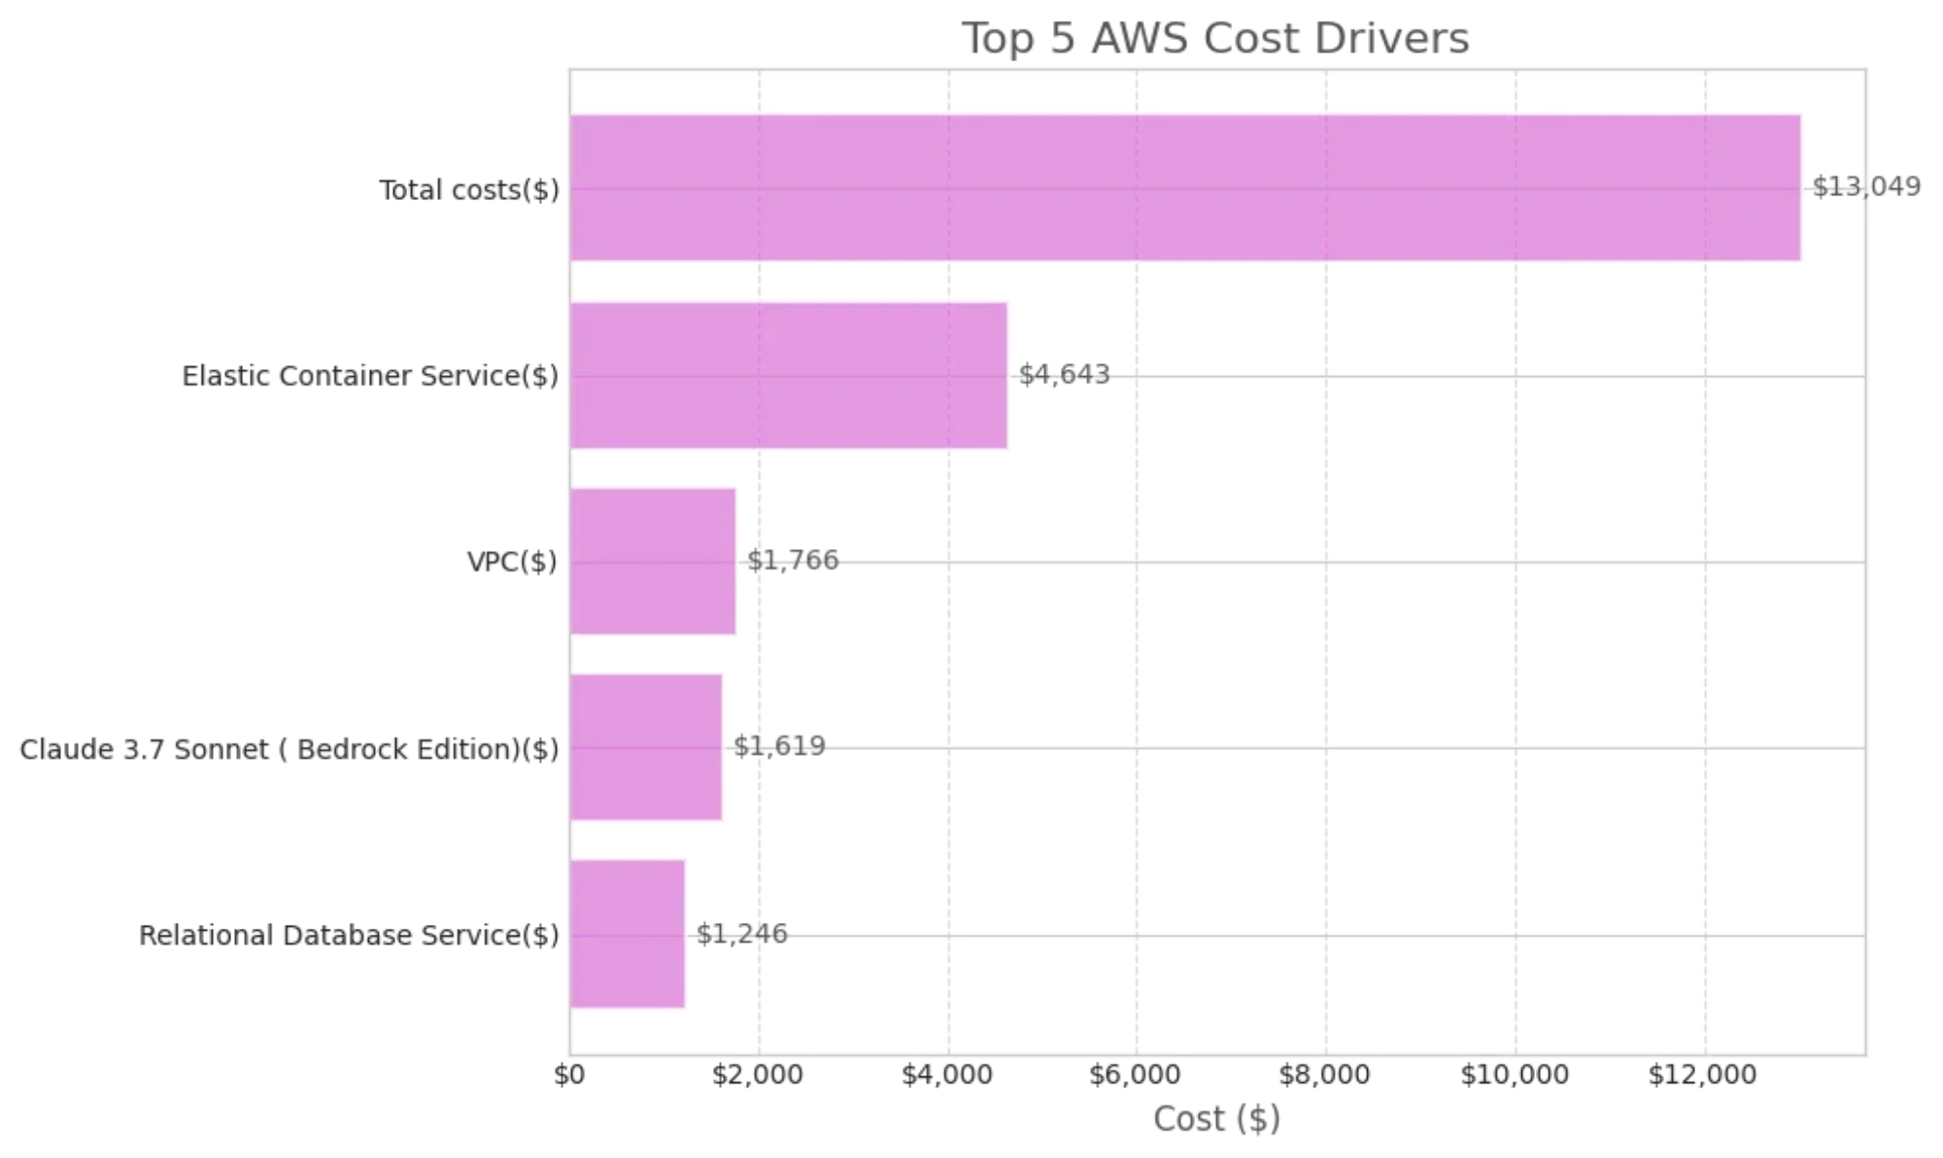
Identifying Key Cost Contributors
Five services account for over 80% of the total AWS expenditure. Understanding these key cost drivers is essential for targeted optimization efforts.
1. Elastic Container Service: $4,642.58
Container orchestration service for running and managing Docker containers
2. Virtual Private Cloud: $1,766.15
Networking service for isolating cloud resources
3. Claude 3.7 Sonnet: $1,619.33
AI language model service via Amazon Bedrock
4. Relational Database Service: $1,245.64
Managed database service for SQL databases
5. Tax: $1,077.43
Applicable taxes on AWS services

Slide 5
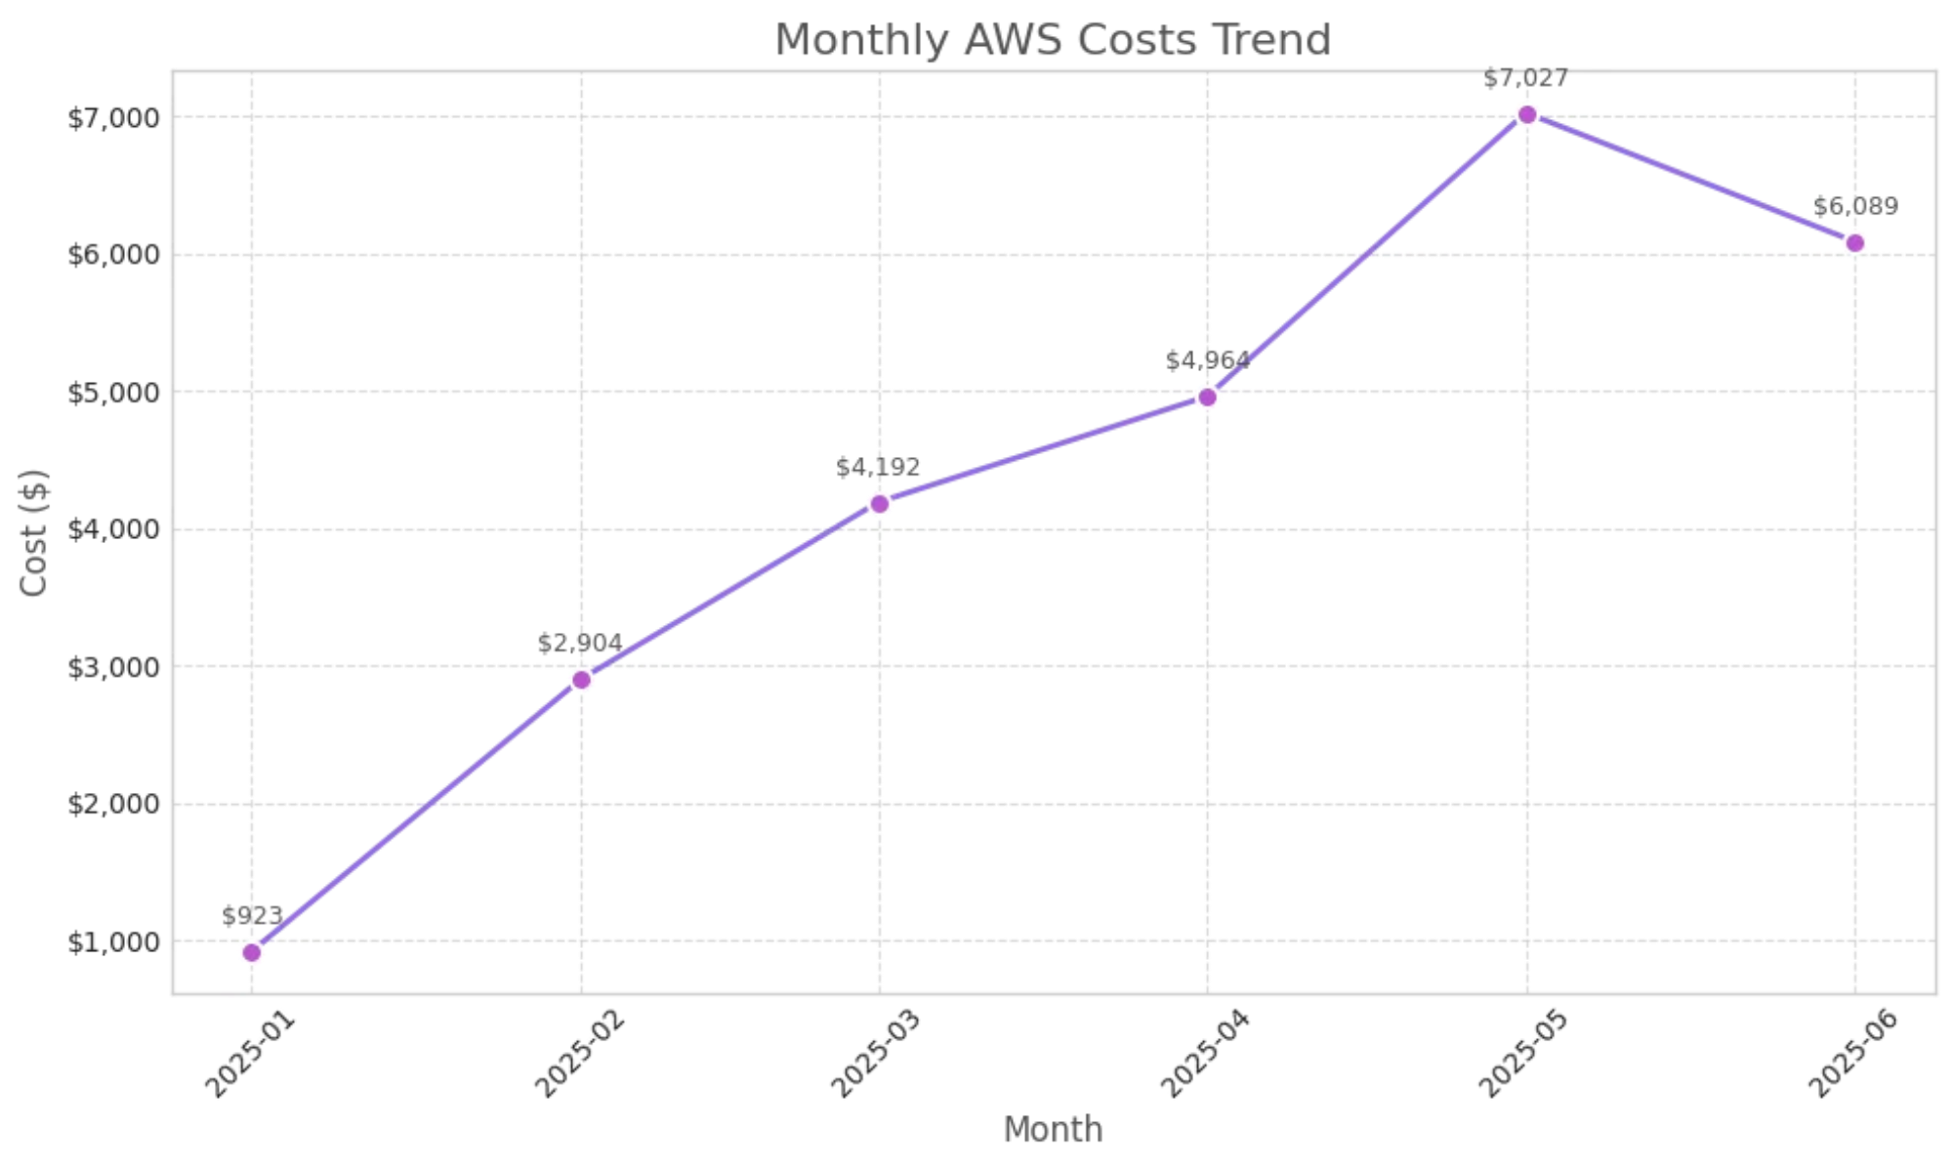



AWS Spending Over Time
Monthly AWS costs show a clear upward trend from January to May 2025, with a slight decrease in June. This pattern reflects the organization's cloud resource utilization and growth.
Costs increased
7.6x
from January ($923) to May ($7,027),
indicating significant expansion of cloud operations
June shows a
13.4%
decrease from May's peak, suggesting
potential optimization efforts or reduced workloads
The steepest monthly increase occurred between February
and March, with costs rising by
44.3%
The average monthly cost across the first half of 2025 is
$4,350
, with significant variance between months

Slide 6


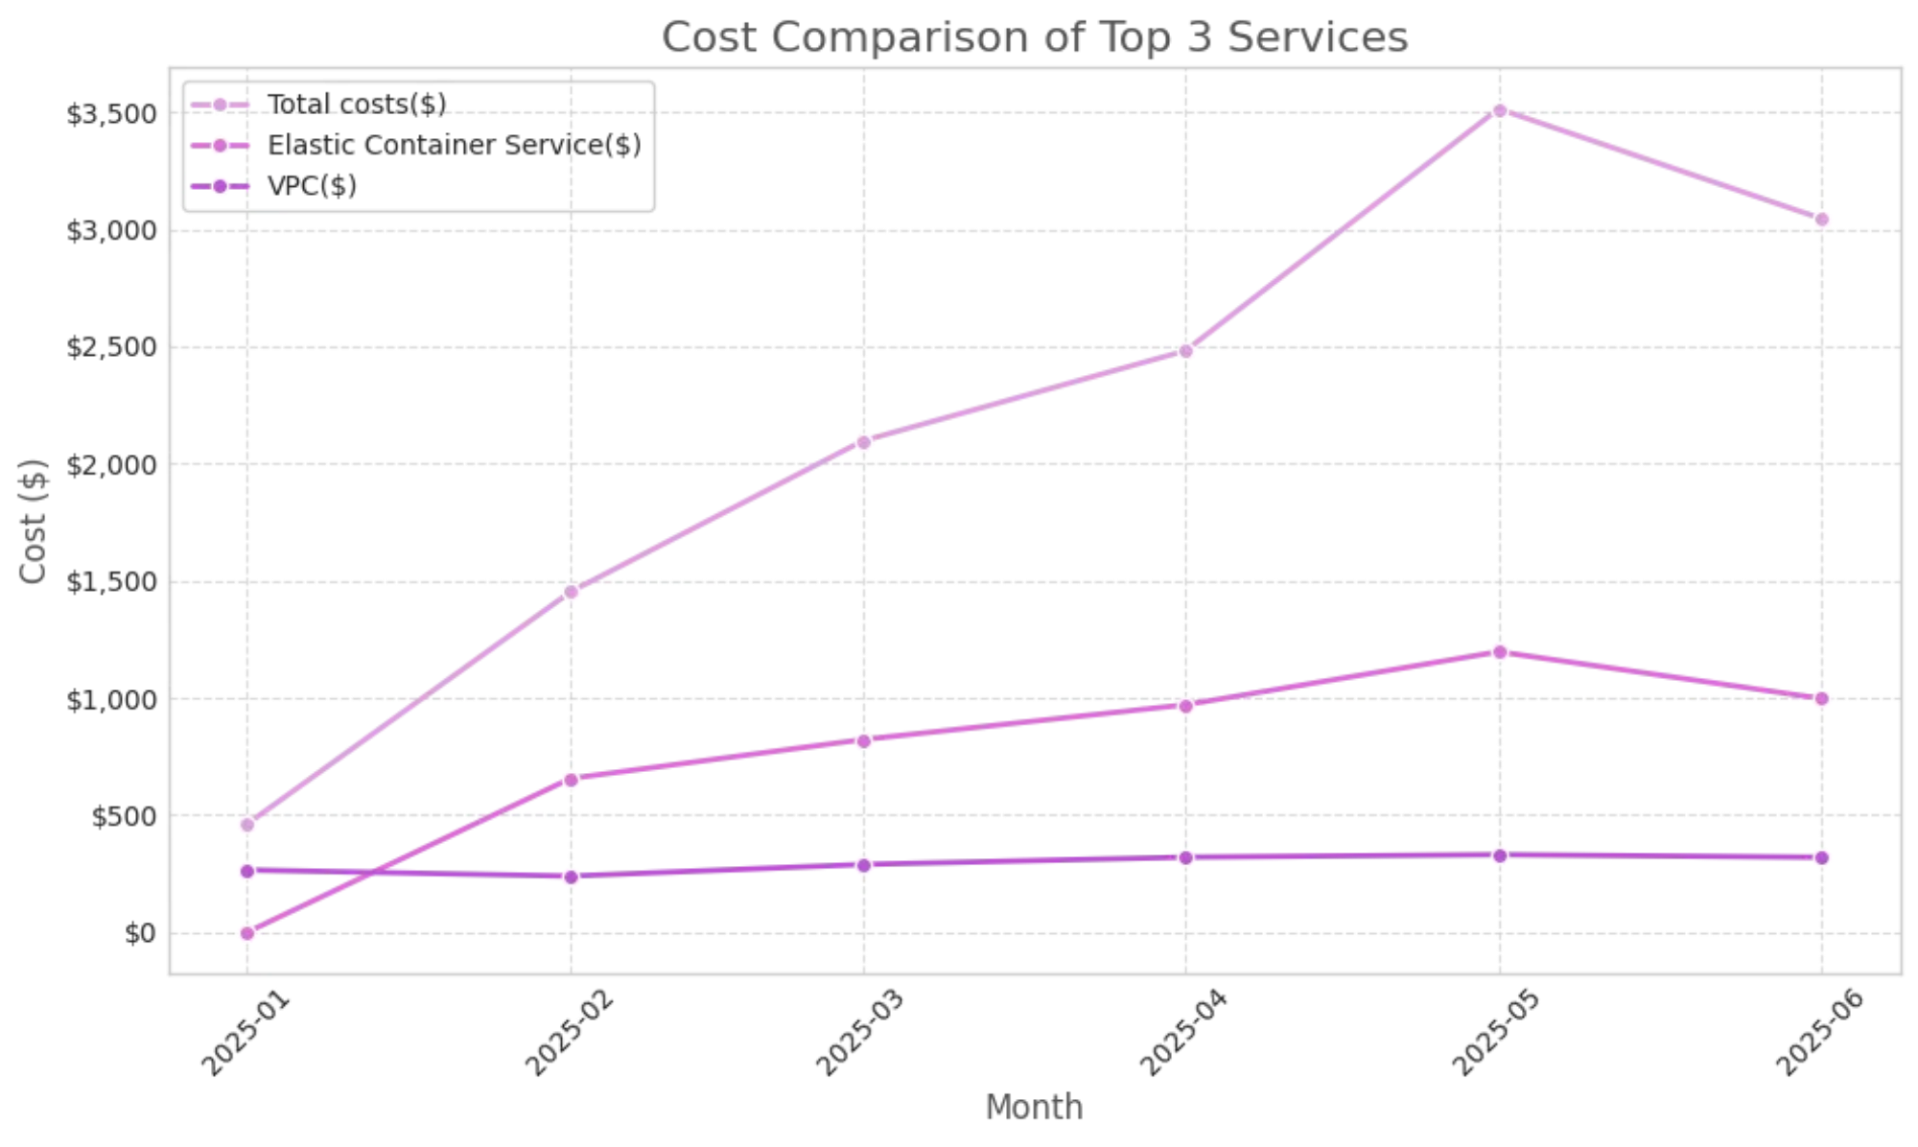


Service Cost Comparison
Comparing the cost trends of top services reveals distinct usage patterns and growth rates. This comparison helps identify which services are driving the overall cost increases.
Elastic Container Service
Shows consistent growth throughout H1 2025, with the steepest increase between April and May. This suggests expanding containerized workloads and applications.
Virtual Private Cloud
Demonstrates more gradual cost increases, indicating stable network infrastructure growth. The costs plateau between May and June.
Claude 3.7 Sonnet
Shows the most dramatic fluctuations, with significant increases in May followed by a decrease in June, suggesting variable AI workload demands.

Slide 7






Elastic Container Service: A Closer Look
Elastic Container Service (ECS) is the largest cost driver, accounting for $4,642.58 (35.6%) of total AWS expenditure. This service provides orchestration for Docker containers, allowing applications to be deployed and managed at scale.
ECS costs have increased by 82% from January to June 2025, with the most significant jump occurring between April and May. This suggests rapid expansion of containerized workloads.
Right-size container instances based on actual resource utilization patterns
Consider Fargate Spot for non-critical workloads to reduce costs by up to 70%
Implement auto-scaling based on time schedules for predictable workloads
Improve cost allocation with comprehensive tagging strategy for containers

Slide 8






Virtual Private Cloud: Network Costs
Virtual Private Cloud (VPC) is the second-largest cost driver at $1,766.15 (13.5%) of total AWS expenditure. VPC provides the networking foundation for AWS resources, enabling secure and isolated cloud environments.
Data Transfer
Cross-AZ and cross-region traffic typically accounts for 60-70% of VPC costs
NAT Gateway
Hourly charges and data processing fees for private subnet internet access
VPN Connections
Site-to-site VPN and client VPN endpoint hourly charges
Endpoint Services
Interface and gateway endpoints for private connectivity
Optimizing VPC costs requires careful architecture planning to minimize cross-AZ data transfer and strategic placement of resources to reduce network traffic costs.

Slide 9




Strategies for Cost Efficiency
Based on the analysis of AWS cost data, several optimization strategies can be implemented to enhance cost efficiency while maintaining performance.
Right-Sizing
Pricing Models
Match instance types to workload requirements
Utilize Savings Plans for predictable workloads
Implement automated scaling based on usage
Leverage Spot Instances for non-critical tasks
Architecture
Monitoring
Minimize cross-AZ data transfer costs
Set up budget alerts and anomaly detection
Implement lifecycle policies for storage
Implement tagging for cost allocation

Slide 10


Summary and Future Actions
Total AWS costs for H1 2025 reached $13,049, with a clear upward trend indicating expanding cloud operations
Five services account for over 80% of costs, with ECS, VPC, and AI services being the primary drivers
Monthly costs increased 7.6x from January to May, with a slight decrease in June suggesting potential optimization
Recommended Next Steps
1
Implement detailed cost monitoring with service-specific alerts
2
Conduct right-sizing analysis for ECS and EC2 resources
3
Evaluate Savings Plans for consistent workloads
4
Review network architecture to minimize cross-AZ data transfer

